Slide 1
Physical and chemical Characteristics of Water
Turbidity of Water
The turbidity is measured by a turbidity rod or by a turbidity meter with optical observations and is expressed as the amount of suspended matter in mg/l or parts per million (ppm). For water, ppm and mg/l are approximately equal. The standard unit is that which is produced by one milligram of finely divided silica (fuller’s earth) in one liter of distilled water.
Turbidity Meters
Turbidity Rod: The turbidity can be easily measured in the field with the help of a turbidity rod. It consists of an aluminium rod which is graduated as to give turbidity directly in silica units (mg/l) Turbidimeter. The turbidity can be easily measured in the laboratory with the help of a instruments called turbidity meter.

Slide 2
. Colour
The presence of colour in water is not objectionable from health point of view, but may spoil the colour of the clothes being washed. The standard unit of colour is that which is produced by one milligram of platinum cobalt dissolved in one litre of distilled water. For public supplies, the colour number on cobalt scale should not exceed 20 and should be preferably less than 10. Colour determined by an instrument is known as tintometer.
Taste and Odour
The extent of taste or odour present in a particular sample of water is measured by a term called odour intensity, which is related with the threshold odour or threshold odour number. Water to be tested is therefore gradually diluted with odour free water, and the mixture at which the detection of odour by human observation is just lost, is determined. The number of times the sample is diluted represents the threshold odour number. For public supplies, the water should generally free from odour, i.e. the threshold number should be 1 and should never exceed 3.

Slide 3
4. Temperature of Water
For potable water, temperature of about about 10 degree celcius is desirable. It should not be more than 25 degree celceius.
5. Specific Conductivity {TDS}
The total amount of dissolved salts present in water can be easily estimated by measuring the specific conductivity of water.

Slide 4
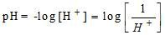

pH value of Water
If H⁺ concentration increases, pH decreases and then it will be acidic. If H⁺ concentration decreases, pH increases and then it will be alkaline
pH + pOH = 14 if the pH of water is more than 7, it will be alkaline and if it is less than 7, it will be acidic. The alkalinity is caused by the presence of bicarbonate of calcium and magnesium or by the carbonates of hydroxides of sodium, potassium, calcium and magnesium. Some, but not all of the compounds that cause alkalinity also cause hardness. pH Measurement: the pH value of water can be measured quickly and automatically with the help of a Potentiometer. The pH can also be measured by indicators as given below:

Slide 5
3. Hardness of Water
Hard waters are undesirable because they may lead to greater soap consumption, scaling of boilers, causing corrosion and incrustation of pipes, making food tasteless etc. Temporary Hardness: If bicarbonates and carbonates of calcium and magnesium are present in water, the water is render hard temporarily as this hardness can be removed to some extent by simple boiling or to full extent by adding lime to water. Such a hardness is known as temporary hardness or carbonate hardness. Permanent Hardness: If sulphates, chlorides and nitrates of calcium or magnesium are present in water, they can not be removed at al by simple boiling and therefore, such water require special treatment for softening. Such a hardness is known as permanent hardness or non-carbonate hardness. It is caused by sulphates,

Slide 6
chlorides, nitrates of Ca and Mg. Carbonate hardness = Total hardness or Alkalinity (which ever is less) Non-carbonate hardness = Total hardness – Alkalinity
Carbonate hardness is equal to the total hardness or alkalinity which ever is less
Non-carbonate hardness is the total hardness in excess of the alkalinity. If the alkalinity is equal to or greater than the total hardness, there is no non-carbonate hardness.
One French degree of hardness is equal to 10mg/l of CaCO3.
One British degree of hardness is equal to a hardness of 14.25mg/l.

Slide 7
Water with hardness upto 75 ppm are considered soft and above 200 ppm are considered hard and in between is considered as moderately hard.
Underground waters are generally harder than surface waters.
The prescribed hardness limit for public supplies range between 75 to 115 ppm.
4. Chloride Content
The chloride content of treated water to be supplied to the public should not exceed a value of about 250 ppm. The chloride content of water can be measured by titrating the water with standard silver nitrate solution using potassium chromate as indicator.
(5) Nitrogen Content
The presence of nitrogen in water may occur in one or more of the following reasons:
Free ammonia: It indicates very first stage of decomposition of organic matter. It should not exceed 0.15mg/l

Slide 8
Albuminous or Organic Matter: It indicates the quantity of nitrogen present in water before the decomposition of organic molten has started. It should not exceed 0.3mg/l
Nitrites: Not fully oxidized organic matter in water.
Nitrates: It indicates fully oxidized organic matter in water (representing old pollution).
Nitrites is highly dangerous and therefore the permissible amount of nitrites in water should be nil.
Ammonia nitrogen + organic nitrogen = kjeldahl nitrogen
Nitrates in water is not harmful. However the presence of too much of nitrates in water may adversely affect the health of infants causing a disease called methemoglobinemia commonly called blue baby disease.
The nitrate concentration in domestic water supplies is limited to 45 mg/l.

Slide 9
. Metal and other chemical substances in water:
Iron – 0.3ppm, excess of these cause discolouration of clothes. Manganese – 0.05ppm Copper – 1.3ppm Sulphate – 250 ppm Fluoride – 1.5 ppm, excess of this effects human lungs and other respiratory organs. Fluoride concentration of less than 0.8 – 1.0 ppm cause dental cavity (tooth decay). If fluoride concentration is greater than 1.5ppm, causing spotting and discolouration of teeth (a disease called fluorosis).
7. Dissolved gases
Oxygen gas is generally absorbed by water from the atmosphere but it being consumed by unstable organic matter for their oxidation. Hence, if the oxygen present in water is found o be less than its saturation level, it indicates presence of organic matter and consequently making the waters

Slide 10
Biological Oxygen Demand (BOD):
The extent of organic matter present in water sample can be estimated by supplying oxygen to this sample and finding the oxygen consumed by the organic matter which is decompose by miroorganim present in water. This oxygen demand is known as Biological oxygen demand (BOD). It is not practically possible to determine ultimate oxygen demand. Hence, BOD of water during the first five days at 20 ⁰C is generally taken as the standard demand.
Loss of oxygen in mg/l x dilution factor. The BOD of safe drinking water must be nil.

Slide 11
Mineral salts
Calcium(Ca) Calcium is one of the most common elements on the earth. It is essential in our body for teeth and bones formation, blood coagulation, right functioning of our nervous system. Calcium ions are contained in almost all spring, drinking water. Health effects caused by hard water, very rich in calcium and magnesium, are unknown. An excess in calcium can alter the water taste or cause scaling problems in pipes and household appliances. If you use a device for the reduction of the content of calcium and magnesium ions dissolved in water (softener), it is important that the calcium content never goes under 60 mg/l. The World Health Organisation recommend a minimum calcium daily intake of about 700 mg. Drinking calcium poor water is considered dangerous for the risk of coronary diseases.

Slide 12
Magnesium (Mg) Magnesium is, with sodium and calcium, among the cations most commonly found in drinking water. In humans magnesium is important for many metabolic functions and for muscular and nervous activity. The daily recommended intake is 150-500 mg.

Slide 13
Sodium (Na) Sodium is an element very diffused on earth and in the biosphere, even if in nature it is almost never in its pure form, but mainly in form of salt (NaCl). Our body contains an average of 100 g of sodium which is an important metabolic regulator for nervous and muscular stimulations. The daily sodium chlorine intake is 20 mg. Due to our diet very rich in salt it is recommended to drink water with a sodic content lower than 20 mg/l, particularly for ipertense people and children. The salt consumption in industrialized countries is considered much higher than the recommended levels (about 3.9 g/day on average). Drinking 2 liters of water containing 20 mg/l of sodium you reach 40 mg, that is about the 5% of the total intake. To reduce the daily sodium intake it would be more logical to change your nutrition: i.e. to eat only integral sea salt, more equilibrate and rich in mineral salts at home, and to avoid precooked food, always rich in refined salt.

Slide 14
Chromium (Cr) Chromium is an important oligoelement for our organism, on condition that certain concentration are not exceeded and the element is not found in toxic or carcinogenic combinations (always due to industrial pollution). At present there is no recommended daily intake. Copper (Cu) Copper is an essential element for our health, but it is toxic at high concentration. A daily intake of 1.2 mg is recommended. Copper pollution in water can originate form copper pipes corrosion by soft, acidic water. Iron (Fe) Food rich in iron is very important, particularly for children and women in fertile age. The recommended daily intake is 10 mg. Iron is usually contained in low amount in drinking water. The WHO recommend a maximum of 0.3 mg/l the EEC of 0.2 mg/l. Possible increasing (lower than 200 mg/l) are not to be considered harmful, even if they make the water not nice to drink and give an unpleasant reddish colour.

Slide 15
Fluorine (F) In someone opinion fluorine is useful for the good health of bones and teeth, sometimes it is even essential, in others opinion it is unnecessary when you are adult, above all if it is added.
Phosphates Phosphate in water originates from detergents and fertilisation and a level higher than 0.1 mg/l indicates pollution. Flora and fauna, very sensitive to phosphate presence, are the main victims. Sulphates Sulphates are sulphuric acid salts combined with metallic ions. Water can naturally contains small quantities of sulphates, but they are mostly transferred in water bodies from the atmosphere and in the atmosphere form road traffic, industries and energetic production. Sulphur oxidised in the air can come back on the soil as acid rain, causing serious environmental problems.

Slide 16
Nitrates and nitrites Nitrates are the main source of nitrogen for plants and an essential constituent for nucleic acids and amino acids. A nitrates water content of about 10 mg/l is considered normal and natural. Different concentration is due to human operations (mauring, air pollution due to transport). The problems resulting from excessive nitrate presence are due to the toxicity of nitrate for human body: nitrates are transformed in nitrites or in carcinogenic nitrosamines.

Slide 17
Aluminium (Al) Aluminium is very abundant on the earth, but is not important for human nutrition. Aluminium can have toxic effects even in small quantities. These effects occur in nervous system, but health effects originating from aluminium intake through water are still on debate. Aluminium concentration is usually lower than 200 mg/l in drinking water. If you drink 1.5 litre of water per day, your daily intake from water is lower than 300 mg/day, a negligible amount if compared with the amount taken by nutrition (10-20 mg/day). There is no evidence that the aluminium assumed through water is more soluble and then more easily digestible, than the aluminium contained in food. Due to all these uncertainties at present there are no rules about its concentration allowed in drinking water. The WHO recommend a concentration lower than 20 mg/l.
https://www.nasa.gov/mission_pages/sunearth/science/atmosphere-layers2.html

Slide 18
Arsenic can be toxic even in low amounts. Nevertheless the arsenic contained in food (amounts ranging from 0.01 to 1.5 mg/kg of dry weight) has a different influence: it carries out some positive metabolic function for our body. Its toxicity is strongly linked on the concentration. Lead (Pb) Lead is poisoning even in small amounts for microorganisms, interfering with haemoglobin formation and with the functionality of central nervous system. Lead is particularly harmful for children, who can suffer long term neurological and behavioural disorders. Major lead sources are paint, vehicle emissions, food and water.

Slide 19
Oxidation-reduction potential
Oxidation-reduction potential (ORP) measures the ability of a lake or river to cleanse itself or break down waste products, such as contaminants and dead plants and animals. When the ORP value is high, there is lots of oxygen present in the water. This means that bacteria that decompose dead tissue and contaminants can work more efficiently. In general, the higher the ORP value, the healthier the lake or river is. However, even in healthy lakes and rivers, there is less oxygen (and therefore lower ORP values) as you get closer to the bottom sediments (mud; see the picture below of a lake bottom).

Slide 20
This is because there are many bacteria working hard in the sediments to decompose dead tissue, and they use up a lot of the available oxygen. In fact, oxygen disappears very quickly in the bottom mud (often within a centimeter or two) and ORP falls quickly. ORP is measured in addition to dissolved oxygen because ORP can provide scientists with additional information of the water quality and degree of pollution, if present. Also, there are other elements that can function like oxygen (in terms of chemistry) and contribute to increased ORP.

Slide 21
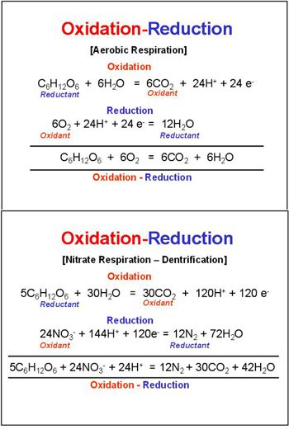

Slide 22
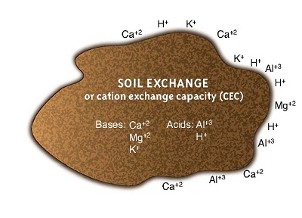
Ion Exchanges

Slide 23
Ion exchange involves the movement of cations (positively charged elements like calcium, magnesium, and sodium) and anions (negatively charged elements like chloride, and compounds like nitrate) through the soils. Cation exchange is much more common.
Cation exchange is the interchanging between a cation in the solution of water around the soil particle, and another cation that is stuck to the clay surface. The number of cations in the soil water solution is much smaller than the number that is attached to soil particles.

Slide 24
The total amount of positive charges that the soil can absorb is called the cation exchange capacity (CEC). CEC impacts how quickly nutrients move through the profile. A soil with a low CEC is much less fertile because it cannot hold on to many nutrients, and they usually contain less clays. If your soil has a low CEC, it is important to apply fertilizer small doses so it does not infiltrate into the groundwater. A soil with a low CEC is less able to hold spilt chemicals.

Slide 25
Anion Exchange:
Anion exchange on clay minerals and soils has not been studied like that of cation exchange. The effect of concentration, mole fraction and complementary ion on the distribution of exchangeable anions (H₂PO₄– HPO₄⁼, CI–, SO₄⁼, NO₃–, MoO₄⁼) seems to be similar to that for cations.
Anion-exchange capacity has been defined as the capacity of a soil to adsorb or release anions under normal soil conditions. The cation to anion exchange capacities of different clay minerals were found.

Slide 26
Household waste
Household waste is defined as “Solid waste comprising of rubbish (such as bottles, cans, clothing, compost, disposables, food packaging, food scraps, newspapers and magazines, and garden trimmings) that originates from private homes, and is also referred to as domestic or residential waste.
Dealing with your household waste is relatively simple. Local councils have a legal duty under the Environmental Protection Act 1990 to collect your household waste, with the cost being incorporated into your yearly council tax charges.

Slide 27
The council will (usually) provide you with two bins, one general waste and one for recycled waste. They are initially provided free of charge and are collected on a set schedule. You may also have a paid-for garden waste bin if required, and you will have free access to local waste and recycling centres.
In addition to normal waste collections, your local council may also offer special collection services for bulky household goods which can be recycled or reused.

Slide 28
Business waste
Commercial or business waste, on the other hand, is defined as any waste produced from a commercial operation including waste from food, packaging, documents, works or repairs, alterations, construction, improvements or demolition.
Unlike household waste, your local council will not automatically collect your business waste for you. In fact, dealing with commercial waste is a lot more complicated to manage. It is law in the UK for business owners to take responsibility and manage their waste effectively.

Slide 29
For health and safety reasons your business waste must be stored in a way that does not obstruct employees or visitors to your premises, and it must be stored in suitable containers, especially if this waste is classed as hazardous waste.
Businesses are also required by law to enter into a contract with a licenced waste carrier to collect and dispose of their waste, you will also need proof of this agreement when challenged. This is where the waste transfer note or Duty of Care documents are needed. The Duty of Care is the code of practice which describes practical guidance on how to meet your waste duty of care requirements. It is as part of the Environmental Protection Act 1990 (section 34(7)). Failure to comply with the duty of care is an offence with no upper limit on the courts’ power to fine.

Slide 30
Ways to Recycle Waste
Recycling means turning an item into raw materials which can be used again, usually for a completely new product.
Establish key partnerships – Seek partnerships with local recyclers, waste management companies, and even colleges and universities that may be interested in related school projects, or even a graduate student thesis.
Use a waste exchange program – What you consider waste can be a resource for another business. Exchange the generated waste through a waste exchange program with such businesses. This can include off-spec products, scrap, excess, small amounts of raw materials that may expire before use, or small amounts that are not enough for a full process run.

Slide 31
Send your food waste to a local farm – Local farms can sometimes feed your food waste to their livestock after treating/heating to food for safety.
Start a company-wide recycling and education program. Start a recycling team to identify other ways to recycle throughout the company. For example, switching to regular silverware in the lunchroom and getting rid of Styrofoam cups by the coffee machine.
Some tips for success:

Slide 32
Communicate your plan clearly to all employees
Make it easy to succeed with clearly labeled bins in convenient locations
Create a “recycling manual” that can be referred to by current and future employees.
Get employee buy-in by engaging them in the process
Offer incentives
Reclaim your chemicals. For example, lead can be reclaimed from batteries and paint. Many solvents that have been used can also be distilled for reuse, like acetone

Slide 33
Soil Pollution
Soil is the upper layer of the earth that is produced by weathering of rocks over thousands of years.
Soil is a mixture of inorganic minerals and organic compounds.
Presence of harmful substances in soil cause severe damage to the quality of soil adversely affecting agricultural productivity. This is called land or soil pollution.

Slide 34
Causes of Soil Pollution
Household / industrial wastes containing organic and inorganic substances, solid wastes, plastics, inorganic chemicals, heavy metals and toxic chemicals are dumped into soil.
Domestic waste, sewage and sludge are the major sources of soil pollution in urban areas.
Large amount of discarded materials viz. concrete, asphalt, paper and rags, leather, plastics, cans, glass and packing materials etc. are usually dumped into soil of landfills.

Slide 35
Causes of Soil Pollution
Acid rain taking place due to air pollution, results in soil pollution, by making the soil acidic and infertile.
Chemicals used to kill insects, rats, snails, fungi, herbs, etc., viz. pesticides, rodenticides, fungicides, herbicides get accumulated in the soil and cause soil pollution.
Radioactive wastes and nuclear wastes from nuclear reactors and nuclear explosions also causes soil pollution.

Slide 36
Effect of Soil Pollution
The toxicity level of soil is increased due to industrial effluents. Heavy metals destroy useful micro-organisms in the soil and also cause diseases.
Excessive use of chemical fertilizers causes soil deterioration, reducing the fertility of soil.
Soil polluted by dumping of sewage can cause the spread of diseases like typhoid, jaundice, dysentery, and gastroenteritis.

Slide 37
Control of Soil Pollution
Recycling of solid waste should be encouraged.
Excessive use of chemical fertilizers and pesticides should be avoided and use of bio-fertilizers and bio-pesticides should be encouraged.
To prevent the reduction of nutrients in soil, the practice of crop rotations should be popularized.
Sewage waste should be converted into organic manure through composting. Bio-gas can be produced from cattle dung.

Slide 38
Afforestation and bioremediation of soil can reduce the soil degradation due to soil erosion.
Biological control of pests should be encouraged by introducing selective pathogenic microbes/ insects.
Atomic power plants should be properly constructed to prevent leakage of radioactive substances into the soil.

Slide 39
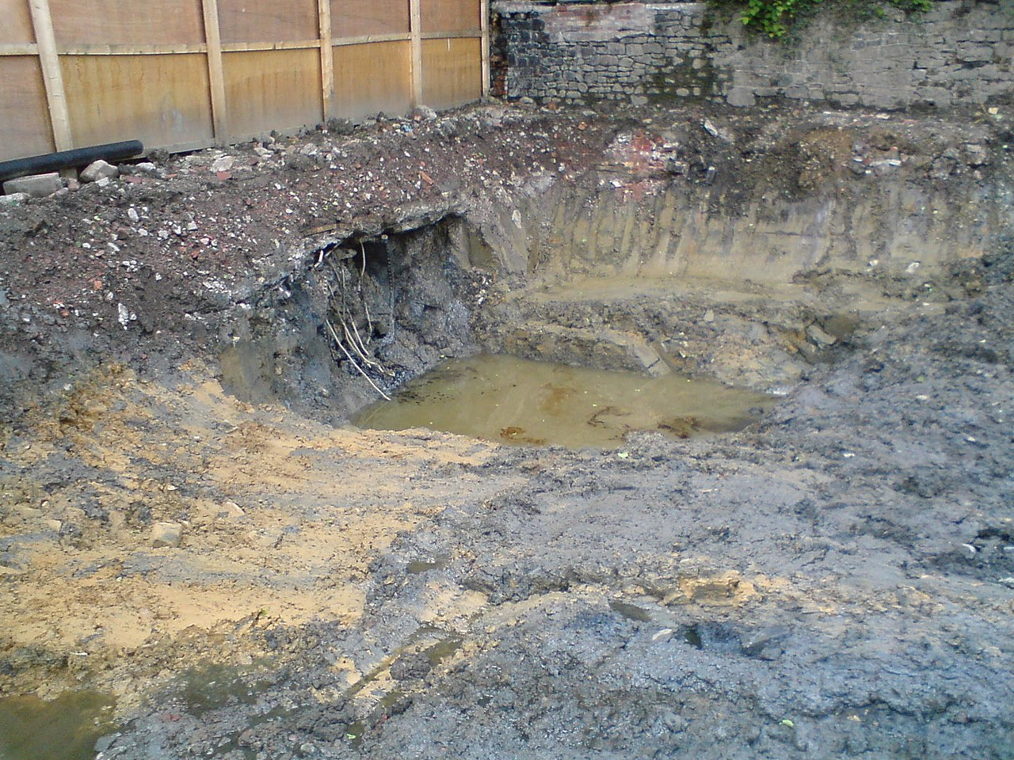

Slide 40
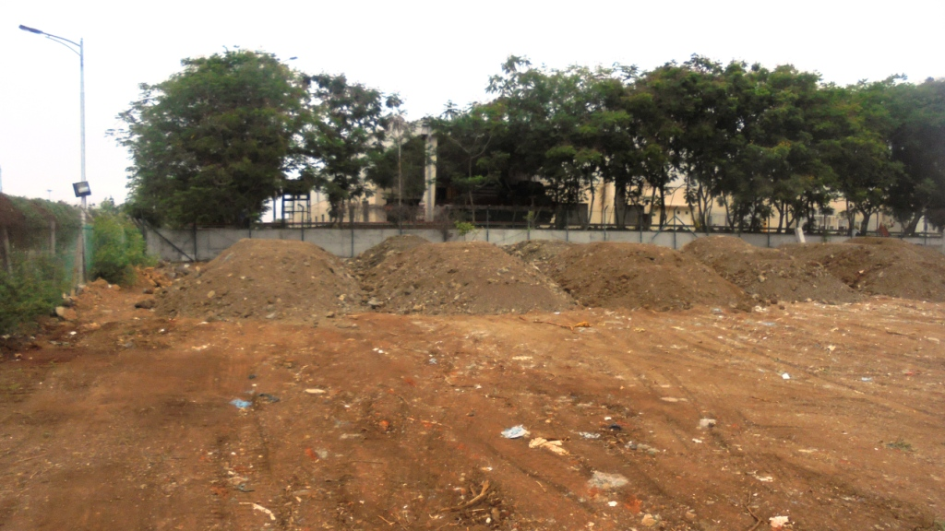

Slide 41
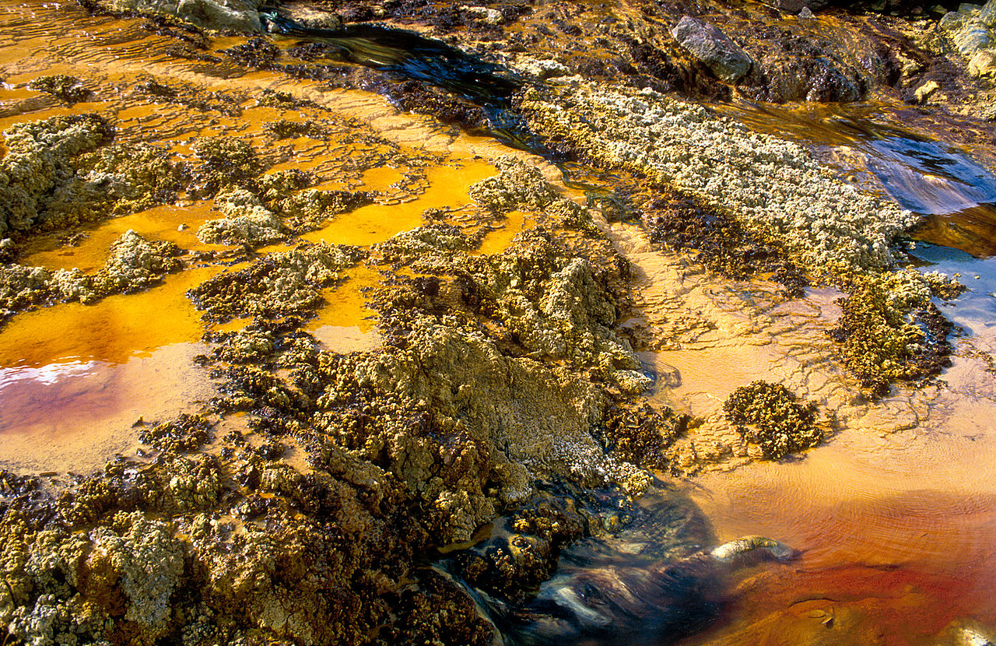

Slide 42
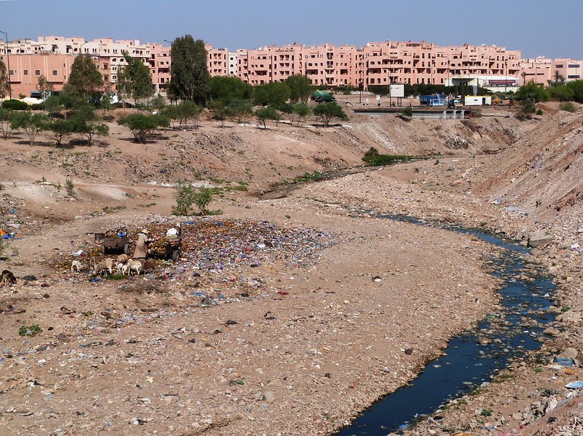

Slide 43
HEAVY METAL
Many metals occur in traces in the earth’s crust. Metals like Pb, Hg, Zn, Cd are heavy metals. Some of the heavy metals are beneficial to organisms in traces. But if excessive levels of heavy metals enter environment through human activities, they endanger health
and survival of humans and other organisms. You shall learn about toxic effects of a few heavy metals in this lesson

Slide 44
Heavy Metal
A heavy metal is one whose density is more than 5g cm–3. Some heavy metals are lead,cadmium, mercury, arsenic selenium, as also iron, copper, manganese, selenium, zinc, etc.
All these metals have atomic number greater than 20. Low concentrations of metal like iron, copper, zinc and some others are essential for organisms. They are called ‘trace metals’. On the other hand metals like lead, mercury, cadmium and some others are toxic
to organisms above a certain concentration.

Slide 45
Sources of Contamination of Environment by Heavy Metals
Heavy metals are introduced into the environment either by natural means or by human activities.
Natural sources: In nature excessive levels of trace metals may occur by geographical phenomena like volcanic eruptions, weathering of rocks, leaching into rivers, lakes and oceans due to action of water.
Anthropogenic Sources : Small amounts of heavy metals are released while mining and uncontrolled smelting of large quantities of metal, ores in open fires. With the industrial revolution, metals were extracted from natural resources and processed in the industries from where heavy metals passed on into the atmosphere.

Slide 46
Following list shows the various human activities through which heavy
metals get into the environment.
(i) Smelting or processing of ores of metals.
(ii) Mining.
(iii) Burning of fossil fuels such as coal, petrol, kerosene oil.
(iv) Discharging agricultural waste.
(v) Discharging industrial waste.
(vi) Discharging domestic waste.
(vii) Discharge from auto exhausts.

Slide 47
How do Heavy Metals Reach the Ecosystem
Many toxic inorganic and organic compounds and heavy metals from sources mentioned above, are deposited and buried in the soil by water. They reach the water bodies when washed off from soil by water. Humus, the organic material present in the soil (which also makes the soil look green) has high affinity for heavy metal cations and extract them from water that passes through the soil. Roots of crops and other plants pick up these compounds along with water and pass on to plants and then plants to animals

Slide 48
Heavy Metal Toxicity
Toxicity in organism is caused by three general mechanisms although the toxic effects on physiology of different organisms. Some of the common mechanisms are :
(i) Metals have strong affinity for sulphur. Sulphydryl (S-H)group is present in some enzymes in the organisms. The metal attaches to S–H group and blocks the active site of the enzyme. The normal functioning of the enzyme gets impaired.
(ii) A heavy metal may displace an essential ion during synthesis of biomolecule. The biomolecule loses its activity e.g. Pb replaces Ca of the bone, making it fragile.
(iii) Metal ions may cause conformational changes in enzymes rendering them inactive.

Slide 49
Toxicity is also caused when the metal blocks the defence proteins of the body which fight infections of organism. Also certain forms of heavy metals can pass through cell membrane protecting vital organs like the brain or foetal membranes in a pregnant mother and cause harm.
Effects of Pb, Hg, Cd and As Contamination
All trace elements have some toxic effects if ingested for a long enough period or at sufficiently high concentrations. We shall now study the sources of contamination and toxic effects of three heavy metals - lead, mercury and cadmium.

Slide 50
Lead : Lead is a very severe pollutant.
Occurance: 0.1% by weight of Pb occurs in the earth’s crust in rocks and soil. It occurs naturally in some plants.
Anthropogenic Sources : Human activities have increased the quantity of lead in the environment. Some such anthropogenic sources are:
(i) Soil forms a dumping ground for Pb from mining, smelting, sewage and agricultural sludge;
(ii) From vehicle exhausts: Tetraethyl lead is mixed with petrol for improving efficiency of intenal combustion engines of vehicles. Fuel evaporating from fuel tank and carburetors and unburnt fuel from mopeds and motor bikes release compounds of Pb through automobile exhausts and it accumulates as dust.

Slide 51
(iii) Lead is also released from industries and reaches the soil from accumulating as dust.
Pb goes into potable (fit for human consumption) water from lead pipes and lead storage tanks. Pipe joints also have Pb in soldering which may be carried along with water flow.
(iv) It is released from lead acid batteries.
(v) Paints like the yellow lead chromate used for marking roads deteriorate and enter the environment.

Slide 52
Properties : Some of the characteristics of lead pollutants are discussed below:
(i) Lead and its compounds accumulate in the soil. They also bio-accumulate but do not biomagnified.
(ii) They are non-biodegradable.
(iii) They remain in the soil and enter food chain when crops take them up.
Toxic effects of Lead: Lead is a severe toxicant. Some of the toxic effects of lead are discussed below:
(i) After getting into human body lead reaches blood and through circulation gets into soft tissues. Lead however ultimately deposits in the bones replacing calcium,

Slide 53
(ii) Absorption of lead is higher in children and in people suffering from calcium deficiency.
It can bioccumulate and remain in the human body for many years. During old age and illness lead moves back from bone to blood to increase level of lead in blood and becomes toxic: It may reach the brain and cause brain damage, convulsion and
behavioural disorders.
(iii) Lead interferes with hemoglobin formation and causes anemia due to deficiency of hemoglobin. Lack of hemoglobin may further cause kidney and brain damage.
(iv) Acute toxicity of lead maybe fatal.

Slide 54
Mercury
Metallic mercury is relatively inert and nontoxic. On inhalation it reaches blood and them to central nervous system and causes severe damage.
Occurance : Mercury is present in the earth’s crust. It also reaches the environment from volcanic gases and evaporation from oceans. Mercury exists as metallic mercury, inorganic salt, and organic methyl mercury. Soil bound mercury is converted into dimethyl
mercury by the action of anaerobic bacteria. Mercury is also present in traces in fossil fuel and minerals. Plants take up mercury from soil and release it as mercury vapour during transpiration as mercury is volatile.

Slide 55
Anthropogenic Sources: Mercury has been in the environment for long even earlier than the 20th century. It reaches the environment in the following ways:
(i) While extracting gold and mercury from the ores.
(ii) Burning of fossil fuels releases mercury vapours into the environment. Coal in India has a high mercury content. If low grade coal is used in thermal power plants, mercury which has a high vapour pressure and high combustion temperature escapes into the
atmosphere and condenses as dust particles.
(iii) Wastes from paper, plastic, caustic soda and chlorine industries release mercury into the environment.
(iv) Mercury compounds are used as fungicides or pesticides because of their toxicity and thus finds ways to environment.

Slide 56
(v) Electrical appliances : Mercury is excellent conductor of electricity, so it is used in electric switches, lamps and batteries. Such appliances are potential source for the release of mercury vapours.
Toxic effects of Mercury: People in Japan suffered from a disease called Minamata
disease due to consumption of mercury poisoned fish.
Minamata disease: In Japan in 1953 mercury poisoning occurred due to consumption of fish which had died of Hg poisoning. Mercury had contaminated the water where it had reached as effluent of a vinyl chloride (ingredient of plastic) factory. Fishermen living in coastal areas of Minamata Bay had eaten the dead fish. They suffered from Minamata disease, whose symptoms were weakened muscles, impaired vision, mental retardation,
paralysis and death.

Slide 57
Mercury is non toxic when swallowed but if inhaled in its volatile form it enters brain through blood stream, causing damage to nervous system. Hence mercury should be handled in a well ventilated room and cleaned up if spilt. Hg ions have affinity for sulphur and cause harm by attaching to sulphur containing amino acid of proteins. Hg ions also bond with haemoglobin and other blood proteins especially those containing sulphydryl groups.
Most toxic to humans are the organo-mercury compounds especially methyl mercury as it disolves in fatty tissues and bio-accumulates and bio-magnifies. Microorganisms convert high levels of inorganic mercury into the organic derivatives like dimethyl mercury.

Slide 58
Methyl mercury compounds are very toxic because of the following reasons :
(i) These compounds can reach brain and interfere with transmission of nerve impulses
(ii) These compounds can cause permanent damage to the central nervous system of foetus of pregnant mothers.
(iii) These compounds also cause increased loss of water from kidney and ultimately causes to death.

Slide 59
Cadmium : Cadmium is highly toxic metal.
Occurrence : The natural sources of cadmium are volcanic activity, spray from oceans and forest fires.
Anthropogenic Sources : Humans activity add more cadmium to atmosphere than natural sources. Coal mining, non-ferrous metal mining, refineries, coal combustion, burning of refuse (water matter) iron and steel industries and phosphate fertilizers are main sources of cadmium. Tobacco containing cadmium is finely dispersed in air when released with cigarette smoke. Cadmium is chemically very similar to zinc. It also occurs with zinc minerals.

Slide 60
Entry of Cadmium into Plants, Animals and Humans
Plants requiring zinc pick up cadmium along with zinc as cadmium occurs alongwith Cadmium, thus enters the food chain. Cadmium in present in from potatoes, wheat, rice and other grains. Sea food also have a high level of cadmium.
Humans get cadmium in their system from tobacco smoking and from tobacco chewing Tobacco leaves absorb cadmium from irrigation water.
Individuals living near and working for mines and smelters processing zinc and electroplating face a heavy risk of cadmium toxicity. Cadmium is soluble in water and reaches the humans working in zinc mines.

Slide 61
Toxic Effects of Cadmium: Cadmium is a cumulative poison. It is retained in the body for a long time and causes
(i) hypertension (high blood pressure),
(ii) heart ailments
(iii) kidney damage
(iv) destruction of red blood cells
(v) damaged mitochondrial function of cells.
Cadmium resembles zinc chemically Ca2+ and Cd2+ share the same charge and have similar size. It may therefore replace zinc in enzymes and thus destroy their catalytic
activity. In Japan, people got a bone disease “itai itai” where Ca++ of bones were replaced by Cd++.

Slide 62
Arsenic
Arsenic oxides were the common poisons used for murder and suicide from roman times through to the middle ages.
Arsenic, which often is described as tasting like bitter almonds, is generally taken into the body by consumption or inhalation from smoke.
Arsenic kills by disrupting the biochemical pathways in the body that produce ATP. As we saw earlier, ATP is an energy molecule that is necessary for the energy that runs the majority of the body's respiratory system. Arsenic both blocks and competes with the chemicals that form ATP, leaving the body depleted of what it needs to keep up even the most basic cellular processes.

Slide 63
The lack of ATP will cause massive neurological and cardiovascular distress. In sufficient concentrations the arsenic will eventually cause multi-system organ failure, most likely from cell apoptosis and hemorrhaging, and then death.

